Slide 1
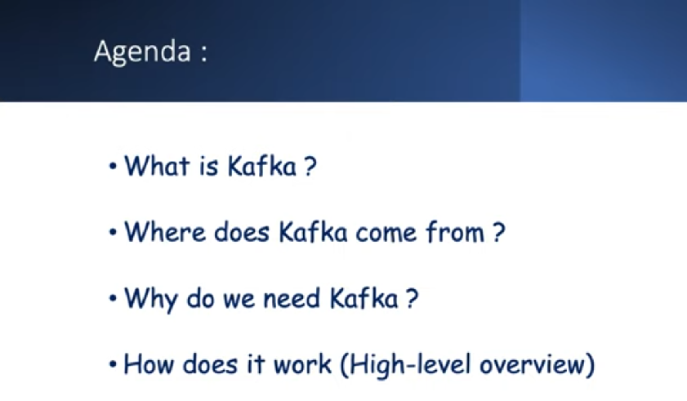

Slide 2
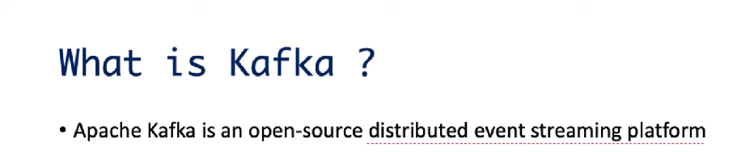
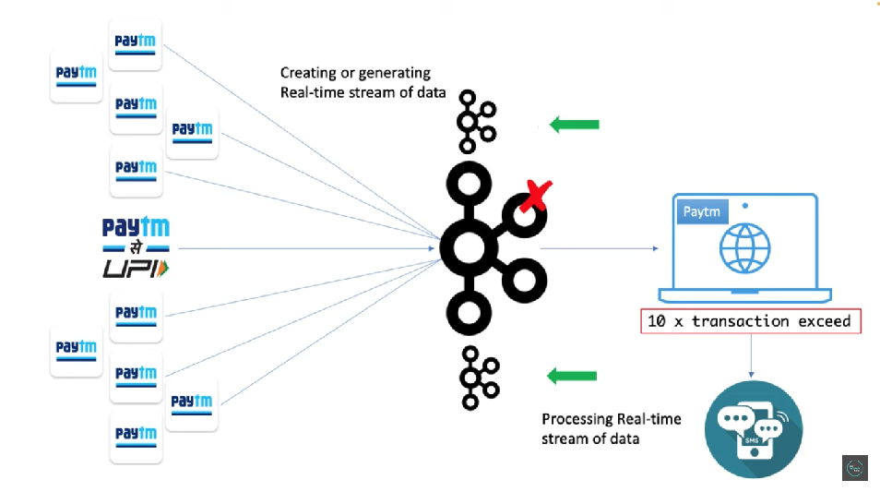

Slide 3
Apache Kafka Server
Messaging system: A messaging system is a simple exchange of messages between two or more persons, devices, etc. A publish-subscribe messaging system allows a sender to send/write the message and a receiver to read that message.
In Apache Kafka, a sender is known as a producer who publishes messages, and a receiver is known as a consumer who consumes that message by subscribing it.
Apache Kafka is a software platform which is based on a distributed streaming process. It is a publish-subscribe messaging system which let exchanging of data between applications, servers, and processors as well.
Apache Kafka was originally developed by LinkedIn, and later it was donated to the Apache Software Foundation

Slide 4
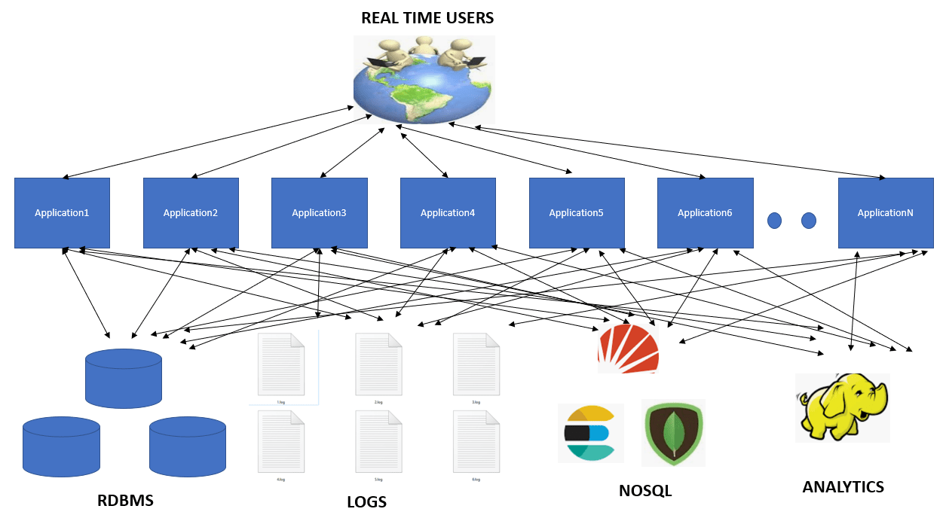
Apache Kafka Server
In a distributed architecture where number of systems interact with each other.
Applications now create and process lot of data.
Complex web of applications involving point to point data movement.
This involves moving large amount of data from one point to another.
Kafka is primarily used to build real-time streaming data pipelines and applications that adapt to the data streams. It combines messaging, storage, and stream processing to allow storage and analysis of both historical and real-time data.

Slide 5
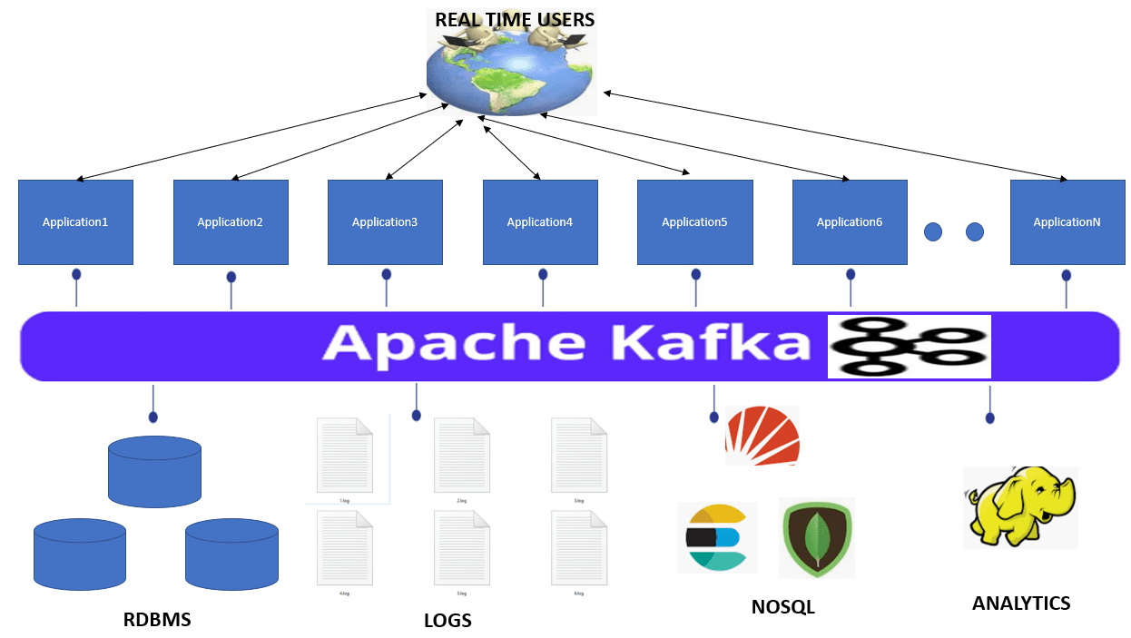
Apache Kafka Server
Apache Kafka is a much Reliable and high throughput streaming system that can move large amount of data between applications.
Traditional Messaging System | Apache Kafka
Limited Scalability | Scalable
Transient in-memory persistence | Messages also stored in replicated log
Comparatively lower throughput | Comparatively higher throughput

Slide 6
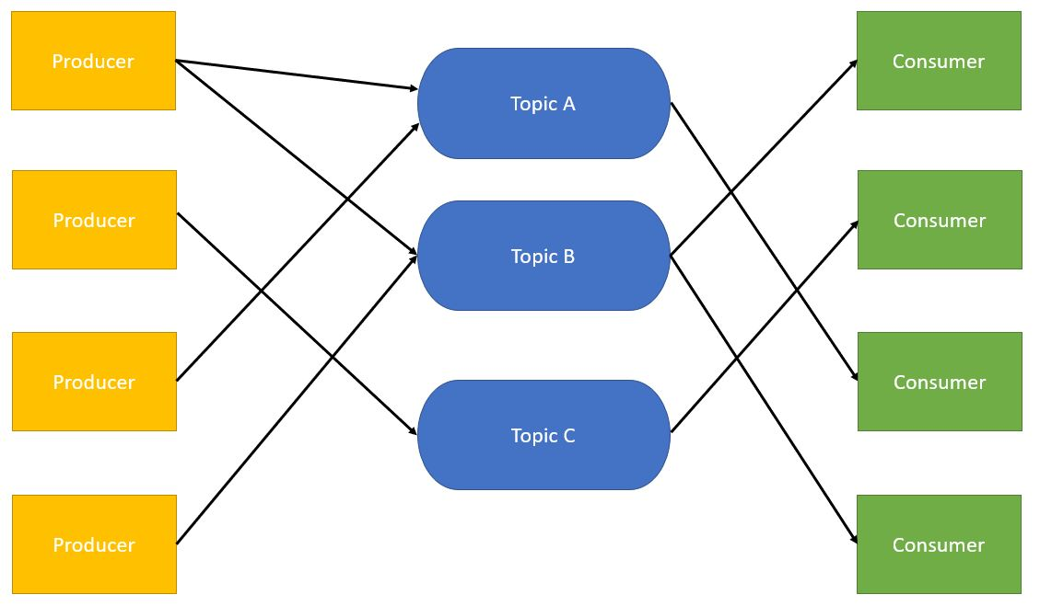
Apache Kafka - Architecture
Apache Kafka Topic
Apache Kafka is a messaging system where messages are sent by producers and these messages are consumed by one or more consumers.
Producers send the messages to Apache Kafka Topics.
From the topics these messages are then consumed by the consumers.
Topics have unique names which are used by producers and consumers for sending/consuming messages. Topics are the base abstraction of where data lives within Kafka.
They can be considered similar to the concept of table in a database.
Each topic is backed by logs which are partitioned and distributed.

Slide 7
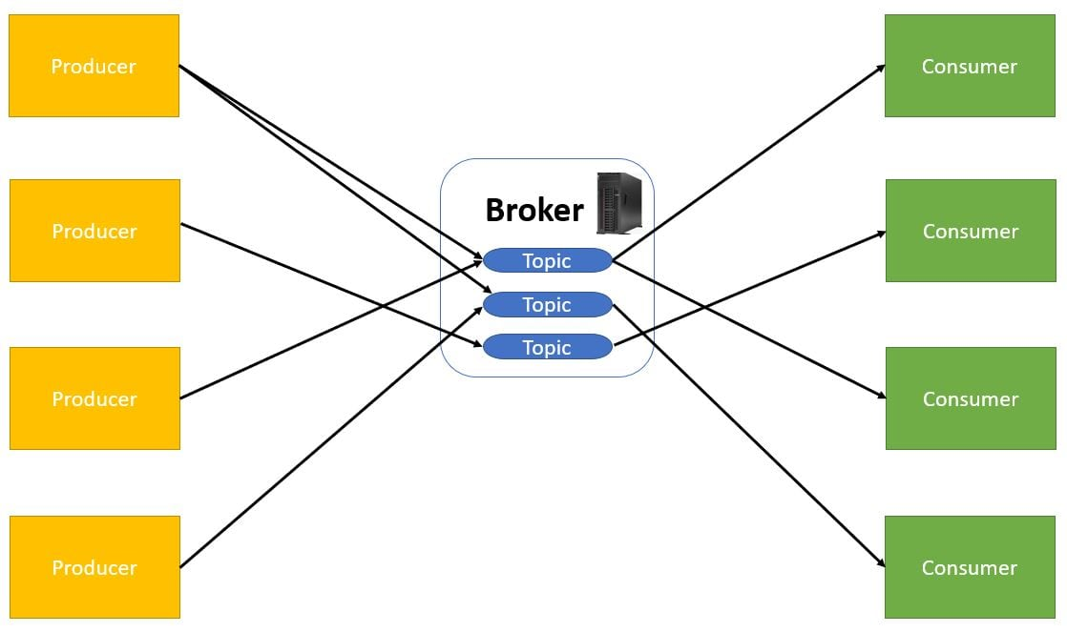
Apache Kafka - Broker
The physical/virtual machines or servers where topics reside are called brokers.
Kafka Broker is a software process that runs on machine.
Broker has access to resources such as file systems where logs are maintained.
A single topic can have multiple partitions running on different brokers.

Slide 8
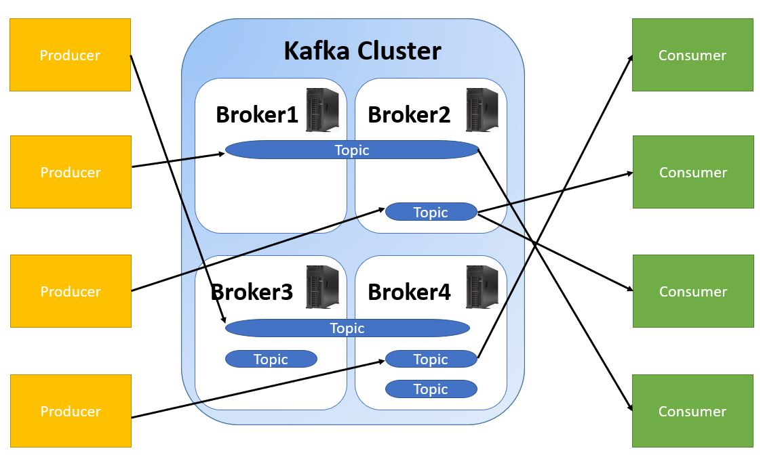
We can add more brokers to scale the Kafka Application.

Slide 9
Apache Kafka - Cluster
The advantages of using Apache Kafka Cluster are as follows -
Clustering - Apache Kafka has a clustered set of brokers that work in unison.
Distributed - The data in Apache Kafka is distributed in all the brokers. This is done by making use of partitions which are distributed across multiple brokers.
Fault Tolerant - Apache Kafka maintains replicated copies of data. So if any broker in the cluster goes down, it does not affect the working of Apache Kafka Cluster. This is done by setting the replication value to greater than 1.
Application scaling - Apache Kafka can be scaled horizontally. This increases the throughput.

Slide 10
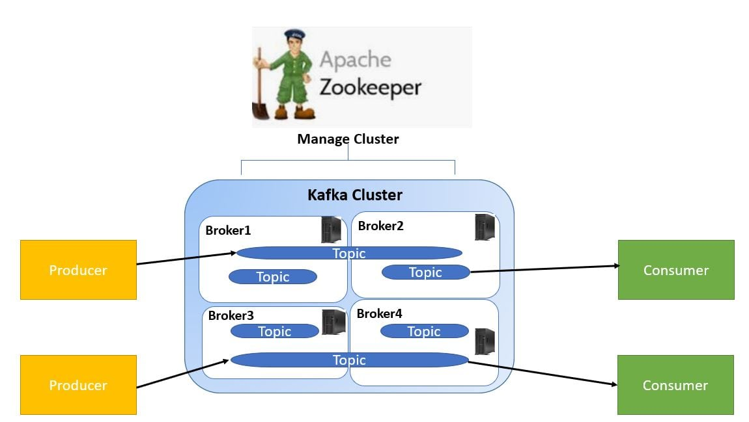
Apache Kafka - Zookeeper

Slide 11
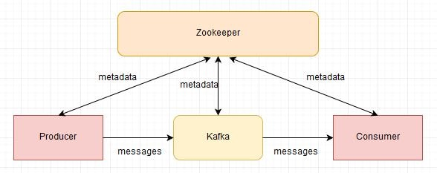
Apache Kafka - Architecture
Apache Zookeeper
To manage the cluster we make use of Apache Zookeeper.
Apache Zookeeper is a coordination service for distributed application that enables synchronization across a cluster.
Zookeeper can be viewed as centralized repository where distributed applications can put data and get data out of it.
It is used to keep the distributed system functioning together as a single unit, using its synchronization, serialization and coordination goals, selecting leader node.
This Kafka installation comes with an inbuilt zookeeper. Zookeeper is mainly used to track status of nodes present in Kafka cluster and also to keep track of Kafka topics, messages, etc.

Slide 12
Apache Kafka Server - steps
Configure the following before starting Kafka server:
Download Apache Kafka: https://kafka.apache.org/downloads
2. Copy the path of the Kafka folder in zookeeper.properties
#dataDir=/tmp/zookeeper
dataDir=D:\kafka\kafka_2.12-3.6.1\zookeeper-data
3. Modify the config/server.properties
log.dirs=D:\kafka\kafka_2.12-3.6.1\kafka-logs
zookeeper.connection.timeout.ms=180000

Slide 13
Apache Kafka Server
Step-1 : Start Zookeeper Server: Open command prompt and enter the following command. After successful launch Zookeeper starts on port : 2181
Step-2: Start Kakfa Server: Open another command prompt and enter the following.
Step-3: Create Kafka Topic: Open another command prompt in the location D:\kafka\bin\windows

Slide 14
Apache Kafka Server
Step-4: Create Kafka Producer: Open another command prompt in the location D:\kafka\bin\windows
Step-5: Create Kakfa Consumer: Open another command prompt in the location D:\kafka\bin\windows
Enter messages on Producer screen, they will reflect on consumer screen.

Slide 15
Apache Kafka Server with Spring Boot application
Create spring boot application(as per the example given)
Start zookeeper server
Start kakfa server
Create topic (it already created not needed)
Start kafka-consumer-console
Start spring boot application
Send message from url – then it will reflect on consumer-console window
** producer-console not required while sending message from spring boot kafka app.

